Slide 1
Dynamic Graphs
&
Tracking Community Evolution
with Graph Autoencoders
June - 2021
Maroun Haddad

Slide 2
Presentation Plan
1
Dynamic Graphs
Introduction
Main Methods
Temporal Graph Networks (TGN)
Model Components and Flow
Tracking Community Evolution
Challenges
Critical Events
Tracking Approaches
Three Community Matching Benchmarks
TrackGAE – Tracking Community Evolution with Graph Autoencoders
Motivation
Model (Pretrain – Tracking)
Evaluation Metrics
Examples
Conclusion
2
3
4
5

Slide 3
Dynamic Graphs
I

Slide 4





Dynamic Graphs - Introduction
2
2
2
2
1
1
1
1
3
3
3
6
6
6
6
7
4
7
4
7
4
7
4
5
8
5
9
8
5
9
8
5
9
Timesteps :
$$t=0$$
$$t=1$$
$$t=2$$
$$t=3$$
Events :
Initial state
New nodes added
New edges added
Nodes removed
Edges removed
Attributes updated
$${G=(V}_{t},E_{t},X_{t})$$
Notes:
We can consider also multidimensional edge changes (no studies exist in this domain)

Slide 5















Dynamic Graphs – Main Methods
[Rossi et al.]
1
2
1
2
1
1
Task Examples
3
$$?$$
Link prediction at time $t$ :
6
6
3
6
6
7
4
7
4
7
4
7
4
$$p((1,7)|t_{3})$$
5
8
5
8
5
2
8
5
2
$$?$$
Dynamic node classification at time t
$$t=0$$
$$t=1$$
$$t=2$$
$$t=3$$
$$p(c_{8}=0|t_{3})$$
$$G_{0}$$
$$G_{1}$$
$$G_{2}$$
$$G_{3}$$
Method 1 (Discrete):
Should take all previous interactions into account
Sequence of Snapshots
Static Embedding Model
Static Embedding Model
Static Embedding Model
Static Embedding Model
Tracking of dynamic clusters *
$$\{G_{0},G_{1},G_{2},G_{3}\}$$
Aggregation
Nodes embedding
Method 2 (Continuous):
Maintain Temporal Memory for nodes
Generate embedding
Time-stamped Events
1
2
3
7
8
Batch of nodes that were part of events
Nodes embedding
$$G=\{x\left(t_{1}\right),x\left(t_{2}\right),…\}$$
Node-wise event
Interaction event

Slide 6
Temporal Graph Networks for Deep Learning on Dynamic Graphs (TGN)
II

Slide 7
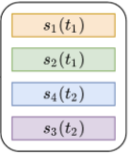
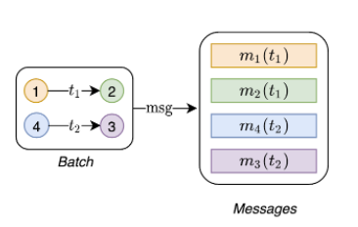
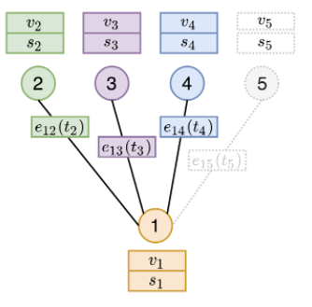
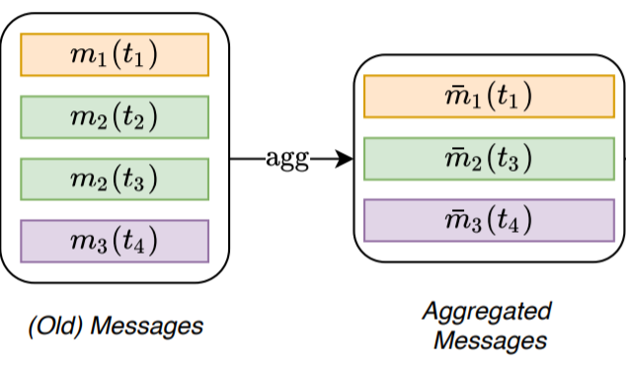
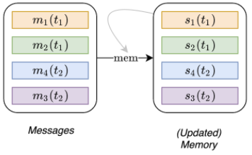



TGN – Main Components
[Rossi et al.]
Memory
Message Function
Message Aggregator
Memory Updater
Node Embeddings
vector $s_{i}(t)$ for each node $i$ at time $t$
New nodes are initialized as zero vectors
The message function can be any function: In the study they use identity :
MLP(Concatenation of the inputs)
Can be any aggregation function:
Mean or take Message of the newest event
Update memory using RNN
*If the messages contain the same node multiple times, we aggregate the messages *
Aggregate neighbors’ memory using TGAT (Temporal Graph Attention Network)
Batch neighbors Sampling (GraphSage)
*Better not to use the memory as embedding to prevent the staleness problem*

Slide 8
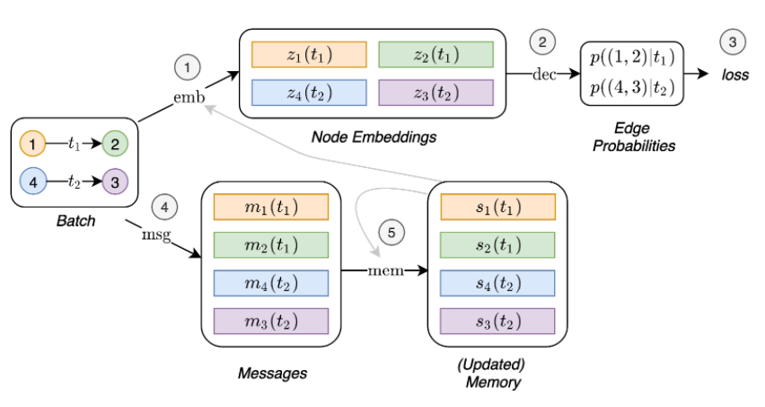
TGN – Simplified Flow
[Rossi et al.]
*Can’t have 4 ,5 before 1,2,3 since this will cause Leakage*
This is a simplified flow of operations which would prevent the training of all the modules in the bottom as they would not receiving a gradient!

Slide 9
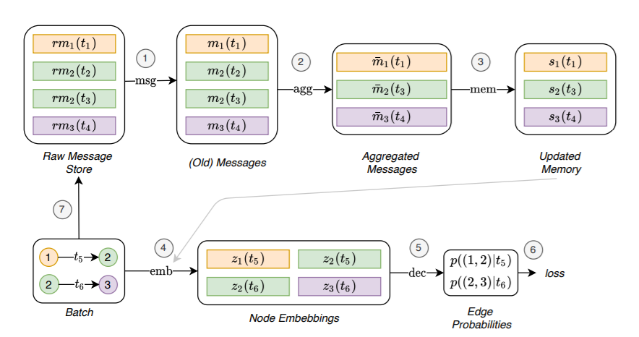
TGN – Actual Training Flow
[Rossi et al.]
Batch size should be small
(200 in paper)

Slide 10


















































TGN – Actual Training Flow
$$G :$$
$$…$$
1
2
1
3
2
4
1
2
1
3
1
2
$$…$$
$$t_{1}$$
$$t_{1}$$
$$t_{2}$$
$$t_{2}$$
$$t_{3}$$
$$t_{3}$$
Previous batch
current batch
$$m_{1}(t_{0})$$
Embedding model
$$m_{2}(t_{0})$$
$$m_{1}(t_{1})$$
$$s_{1}(t_{0})$$
$$s_{3}(t_{1})$$
$$s_{2}(t_{2})$$
$$s_{4}(t_{2})$$
$$s_{1}(t_{2})$$
$$s_{1}(t_{2})$$
$$m_{2}(t_{1})$$
$$s_{2}(t_{0})$$
1
$$m_{1}(t_{1})$$
$$Max$$
$$GRU$$
Update
$$s_{1}(t_{2})$$
3
2
4
1
$$m_{3}(t_{1})$$
$$s_{2}(t_{2})$$
$$t_{1}$$
$$t_{2}$$
$$t_{2}$$
$$t_{2}$$
$$t_{1}$$
$$m_{2}(t_{2})$$
$$m_{1}(t_{1})$$
$$m_{1}(t_{2})$$
$$s_{3}(t_{1})$$
$$m_{4}(t_{2})$$
$$m_{2}(t_{1})$$
Aggregate Messages
Recent event per node
$$m_{2}(t_{2})$$
$s_{1}\left(t_{2}\right)=GRU(m_{1}\left(t_{2}\right),s_{1}\left(t_{0}\right)$)
$$s_{4}(t_{2})$$
1
2
3
$$m_{1}(t_{1})$$
$$m_{3}(t_{1})$$
$$s_{1}(t_{2})$$
$$s_{2}(t_{2})$$
$$s_{3}(t_{1})$$
$$m_{1}(t_{2})$$
$$m_{3}(t_{1})$$
$$m_{4}(t_{2})$$
$s_{2}\left(t_{2}\right)=GRU(m_{2}\left(t_{2}\right),s_{2}\left(t_{0}\right)$)
$$m_{2}(t_{2})$$
$$m_{2}(t_{2})$$
$$s_{3}\left(t_{1}\right)=0$$
Memory
$$m_{1}(t_{3})$$
$$m_{4}(t_{2})$$
$$s_{4}\left(t_{2}\right)=0$$
$$TGAT$$
$$TGAT$$
$$m_{3}(t_{3})$$
$$m_{1}(t_{2})$$
$$TGAT$$
$$m_{1}(t_{3})$$
$$m_{2}(t_{2})$$
$$m_{2}(t_{3})$$
Raw Message Store
$$m_{1}\left(t_{3}\right)=MLP(s_{1}(t_{2})||s_{3}(t_{1}))$$
$$z_{1}(t_{3})$$
$$z_{2}(t_{3})$$
$$z_{2}(t_{3})$$
Update
$$m_{3}\left(t_{3}\right)=MLP(s_{3}(t_{1})||s_{1}(t_{2}))$$
$$m_{1}\left(t_{3}\right)=MLP(s_{1}(t_{2})||s_{2}(t_{2}))$$
Decoder
$$MLP$$
$$m_{2}\left(t_{3}\right)=MLP(s_{2}(t_{2})||s_{1}(t_{2}))$$
Positive Samples
$MLP(z_{1}(t_{3})$. $z_{2}(t_{3})$)
$MLP(z_{1}(t_{3})$. $z_{3}(t_{3})$)
Negative Samples
$MLP(z_{1}(t_{3})$. $z_{4}(t_{3})$)
$MLP(z_{2}(t_{3})$. $z_{4}(t_{3})$)
Backpropagation
Error

Slide 11
Tracking Community Evolution
III

Slide 12
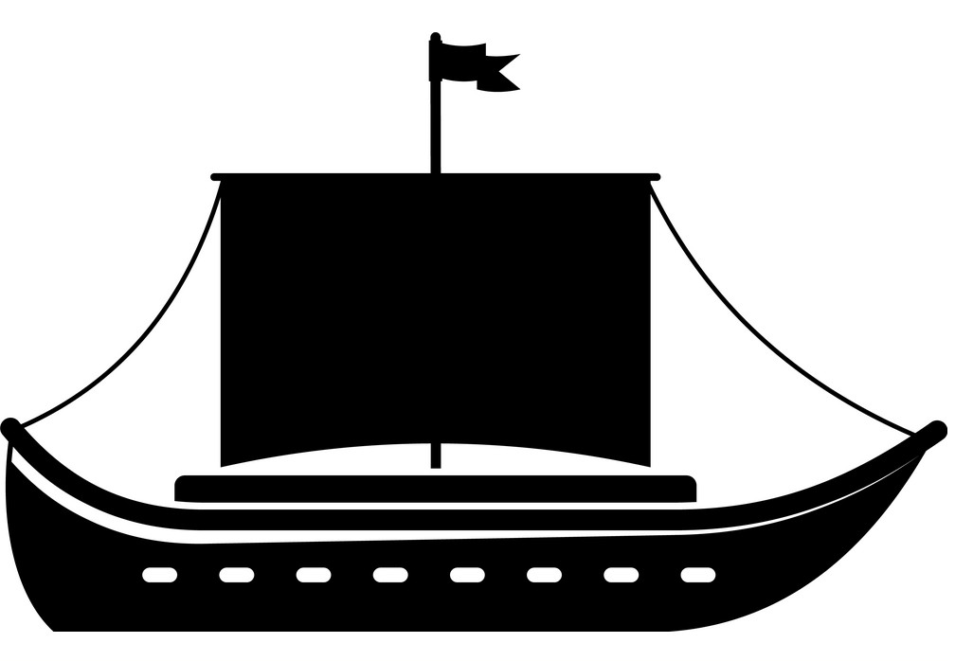




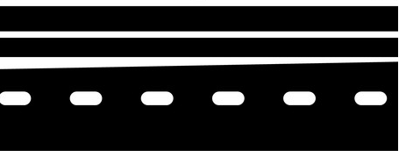



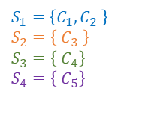



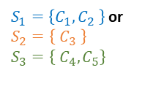











Tracking Community Evolution – Ship of Theseus
[Cazabet et al.]
$$Year 1$$
$$Year 2$$
$$Year 3$$
$$Year 4$$
$$Year 5$$
At which moment can we consider the ship of Theseus as a totally different ship?
$$t_{1}$$
$$t_{2}$$
$$t_{3}$$
$$t_{4}$$
$$t_{5}$$
$$C_{1}$$
$$C_{2}$$
$$C_{3}$$
$$C_{4}$$
$$C_{5}$$
Form sequences by matching clusters from different time-steps.
$S_{1}=\left\{C_{1},C_{2},C_{3},C_{4},C_{5}\right\}$ or
$S_{1}=\left\{C_{1},C_{2},C_{3} \right\}$ or
$$S_{2}=\left\{ C_{4},C_{5} \right\}$$
$S_{1}=\left\{C_{1},C_{2} \right\}$ or
$$S_{2}=\left\{ C_{3} \right\}$$
$$S_{3}=\left\{ C_{4},C_{5}\right\}$$
$$S_{1}=\left\{C_{1},C_{2} \right\}$$
$$S_{2}=\left\{ C_{3} \right\}$$
$$S_{3}=\left\{ C_{4}\right\}$$
$$S_{4}=\left\{ C_{5}\right\}$$
What are the most representative sequences?

Slide 13






























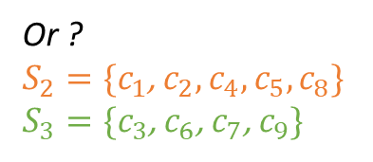



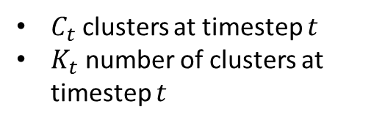



































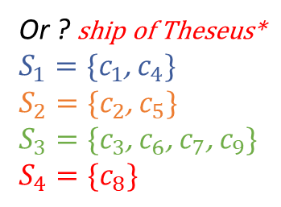
















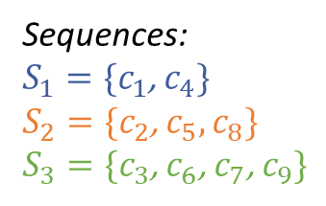
Tracking Community Evolution – Introduction
$$t=0$$
$$c_{1}$$
$$t=1$$
$$t=2$$
$$7$$
$$c_{4}$$
$$7$$
$$11$$
$$7$$
$$C_{t}=\{c_{t}^{1},c_{t}^{2},c_{t}^{2},…,c_{t}^{K_{t}}\}$$
$$6$$
$$11$$
$$5$$
$$c_{2}$$
$$6$$
$$11$$
$$5$$
$$c_{5}$$
$$6$$
$$5$$
$$c_{8}$$
$$1$$
$$1$$
$$12$$
$$1$$
$C_{t}$ clusters at timestep $t$
$K_{t}$ number of clusters at timestep $t$
$$4$$
$$12$$
$$4$$
$$12$$
$$c_{6}$$
$$c_{7}$$
$$c_{9}$$
$$2$$
$$3$$
$$c_{3}$$
$$2$$
$$3$$
$$2$$
$$8$$
$$8$$
$$8$$
$$9$$
$$10$$
$$9$$
$$10$$
$$9$$
$$G_{0}$$
$$G_{1}$$
$$G_{2}$$
Sequences:
$S_{1}=\{c_{1}$, $c_{4}\}$
$S_{2}=\{c_{2}$, $c_{5},c_{8}\}$
$S_{3}=\{c_{3}$, $c_{6}\text{,} c_{7}\text{,} c_{9}\}$
$$6$$
$$11$$
Shrink
$$6$$
dissolve
$$4$$
$$12$$
$$4$$
$$12$$
$$c_{1}$$
$$c_{4}$$
Merge
$$6$$
Or ?
$S_{2}=\{c_{1}$, $c_{2},c_{4},c_{5},c_{8}\}$
$S_{3}=\{c_{3}$, $c_{6}\text{,} c_{7}\text{,} c_{9}\}$
$$7$$
$$7$$
$$5$$
Grow
$$5$$
Grow
$$11$$
$$12$$
$$1$$
$$c_{2}$$
$$11$$
$$7$$
$$1$$
$$c_{5}$$
$$5$$
$$c_{8}$$
$$1$$
Or ? ship of Theseus*
$S_{1}=\{c_{1}$, $c_{4}\}$
$S_{2}=\{c_{2}$, $c_{5}\}$
$S_{3}=\{c_{3}$, $c_{6}\text{,} c_{7}\text{,} c_{9}\}$
$$S_{4}=\{c_{8}\}$$
$$2$$
$$8$$
$$2$$
$$8$$
$$9$$
Shrink
$$8$$
$$2$$
$$3$$
Divide
$$c_{6}$$
$$9$$
$$10$$
$$9$$
$$c_{9}$$
$$c_{3}$$
$$3$$
$$10$$
$$c_{7}$$

Slide 14





Tracking Community Evolution – Critical Events
[Dakiche et al.]
$$t^{−1}$$
$$t$$
Splitting/
Division
Birth/
Formation
Events
Birth
Death
Shrinking
Growing
Splitting
Merging
Continuing
Resurgence
Death/
Dissolution
Merging
Shrinking/
Contraction
Continuing
$$t^{−n}$$
$$t^{−1}$$
$$t$$
Growing/
Growth
Death
Resurgence/
Reformation
Notes:
Sometimes we add threshold in order to consider growth or shrinking or division...

Slide 15







Tracking Community Evolution – Approach 1
[Dakiche et al.]
$$t=0$$
$$t=1$$
$$t=2$$
Matching clusters from different timesteps:
Similarity Measure
Similarity Threshold
Extract clusters
Extract clusters
Extract clusters
$$G_{2}$$
Similarity Measure $≥$ Similarity Threshold
$$G_{0}$$
$$G_{1}$$
matching
matching
matching
matching
1) Independent community detection and matching
Notes:
Some algorithms consider overlapping sequences
Can also match snapshots across the entire lifetime of the graph in order to detect resurgence events

Slide 16




Tracking Community Evolution – Approach 2
[Dakiche et al.]
$$t=0$$
$$t=1$$
$$t=2$$
Use clusters of the pervious snapshot as input clusters to generate the clusters of the current snapshot
$$G_{0}$$
$$G_{1}$$
$$G_{2}$$
*Use iterative algorithm such as Louvain*
Clustering algorithm
Clustering algorithm
Clustering algorithm
Extract clusters
Extract clusters
Extract clusters
2) Dependent community detection
Notes:
Might not detect abrupt changes
Cannot detect resurgence events
Works on consecutive snapshots only
*Louvain is iterative, evaluates modularity (density intra edges vs density inter edges). It starts with every node as a cluster and then groups nodes iteratively until it reaches the optimal modularity.

Slide 17




Tracking Community Evolution – Approach 3
[Dakiche et al.]
$$t=0$$
$$t=1$$
$$t=2$$
Connect same nodes from different snapshots to form a single graph
Apply a static clustering algorithm on the entire graph
$$G_{0}$$
$$G_{1}$$
$$G_{2}$$
Clustering algorithm
3) Simultaneous community detection on all snapshots
Notes:
This method cannot detect division and merging events

Slide 18
Tracking Community Evolution – Approach 4
[Dakiche et al.]
$$t=0$$
$$t=1$$
$$t=2$$
Generate clusters for the first snapshot
Assign the nodes for the current snapshot to the clusters of the previous snapshot
$$G_{0}$$
changes
$$G_{1}$$
changes
$$G_{2}$$
Clustering algorithm
*Can use the edge count to determine the membership of the node*
Extract clusters
Previous timestep clusters
Previous timestep clusters
4) Dynamic community detection on temporal networks
Notes:
Does not detect resurgence events.
Might be limited to initial clusters

Slide 19

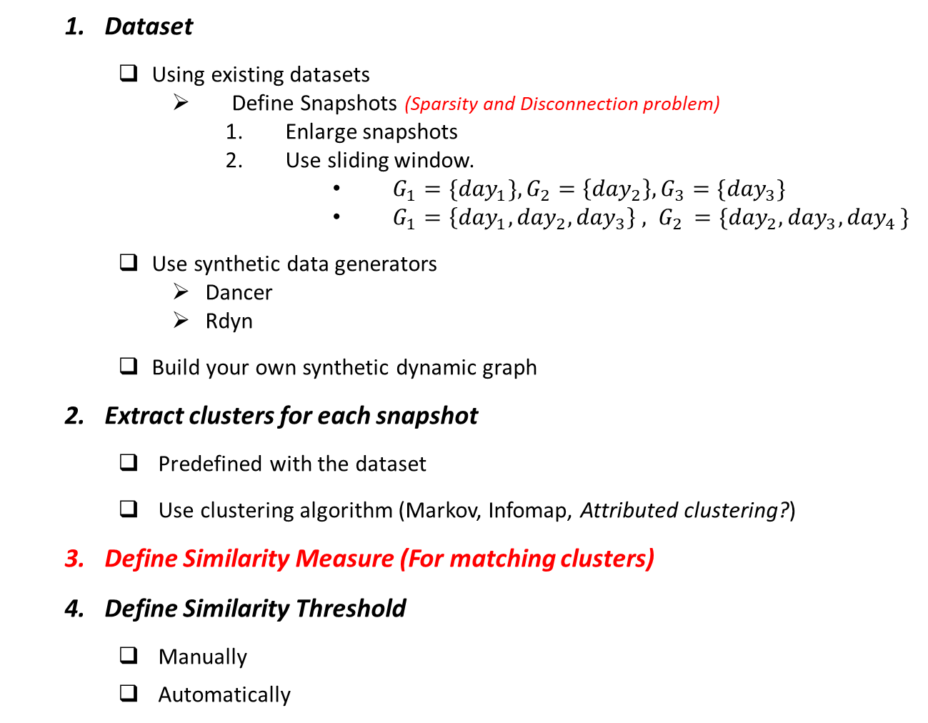






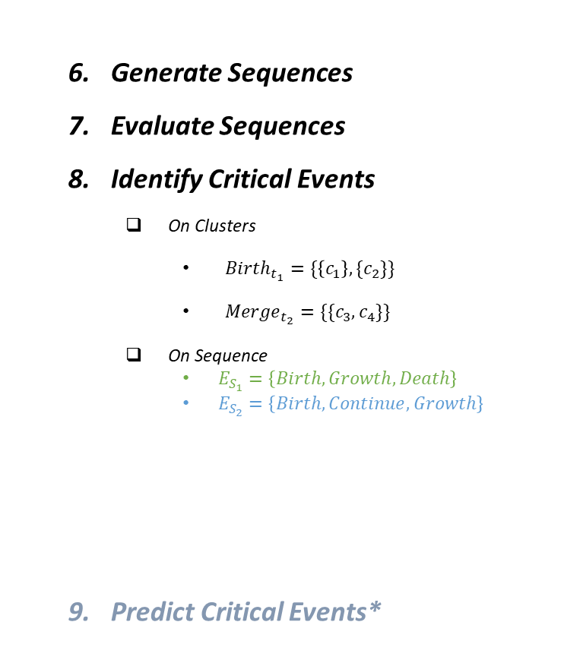

Independent Community Detection and Matching – Main Steps
Dataset
Using existing datasets
Define Snapshots (Sparsity and Disconnection problem)
Enlarge snapshots
Use sliding window.
$G_{1}={\{day}_{1}\}, G_{2}=\left\{{day}_{2}\right\}, G_{3}=\{{day}_{3}\}$
$G_{1}=\left\{{day}_{1},{day}_{2},{day}_{3}\right\} , G_{2 }=\{{day}_{2},{day}_{3}{,day}_{4}\}$
Use synthetic data generators
Dancer
Rdyn
Build your own synthetic dynamic graph
Extract clusters for each snapshot
Predefined with the dataset
Use clustering algorithm (Markov, Infomap, Attributed clustering?)
Define Similarity Measure (For matching clusters)
Define Similarity Threshold
Manually
Automatically
Generate Sequences
Evaluate Sequences
Identify Critical Events
On Clusters
${Birth}_{t_{1}}=\{\left\{c_{1}\right\},\{c_{2}\}\}$
${Merge}_{t_{2}}=\{\{c_{3},c_{4}\}\}$
On Sequence
$E_{S_{1}}=\left\{Birth, Growth, Death\right\}$
$E_{S_{2}}=\left\{Birth, Continue, Growth\right\}$
Predict Critical Events*
$$t_{1}$$
$$t_{2}$$
$$t_{3}$$
$$c_{1}$$
$$c_{3}$$
$$c_{2}$$
$$c_{4}$$
$$c_{5}$$

Slide 20
















Community Matching – Green et al. (Jaccard Index)
[Green et al.]
Similarity Measure : Jaccard Index$→sim\left(C_{t}^{i},F_{t−1}\right)=\frac{|C_{t}^{i}∩F_{t−1}|}{|C_{t}^{i}∪F_{t−1}|}$
Allows for intersecting sequences
Only looks at consecutive snapshots
Only evaluates node membership
Similarity Threshold : Defined statically $→$ 0.3
$$t=0$$
$$t=1$$
$$t=2$$
$$10$$
$$3$$
$$4$$
$$1$$
$$2$$
$$1$$
$$2$$
$$1$$
$$5$$
$$2$$
$$9$$
$$7$$
$$C_{0}^{1}$$
$$9$$
$$7$$
$$9$$
$$7$$
$$C_{1}^{1}$$
$$C_{2}^{1}$$
$$3$$
$$4$$
$$3$$
$$4$$
$$8$$
$$10$$
$$5$$
$$C_{0}^{2}$$
$$8$$
$$5$$
$$6$$
$$6$$
$$C_{1}^{2}$$
$$C_{2}^{2}$$
$$10$$
$$11$$
$$12$$
$$8$$
$$6$$
$$C_{0}^{3}$$
$$13$$
$$C_{3}^{2}$$
Sequences (Fronts in red)
$$S_{1}$$
$$S_{2}$$
$$S_{3}$$
$$S_{4}$$

Slide 21
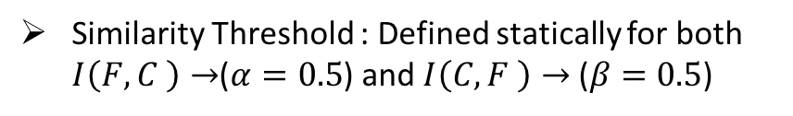



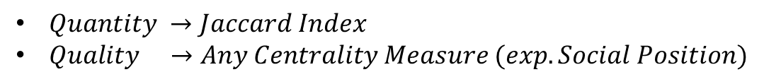
Community Matching – Group Evolution Discovery (GED)
[Brodka et al.]
Similarity Measure : Inclusion$→Quantity∗Quality$
Same matching method as Green et al.
Matching goes beyond node membership and looks at the role of the nodes in each cluster
$Quantity →Jaccard Index$
$Quality →Any Centrality Measure (exp.Social Position)$
Similarity Threshold : Defined statically for both $I\left(F,C \right)→$($α=0.5$) and $I\left(C,F \right)→$ ($β=0.5$)
$$Quality$$
$$I\left(F,C \right)=\frac{|F∩C|}{|F∪C|}∗\frac{\sum_{v∈(F∩C)}{{SP}_{F}(v)}}{\sum_{v∈(F)}{{SP}_{F}(v)}}$$
$$Quantity$$

Slide 22
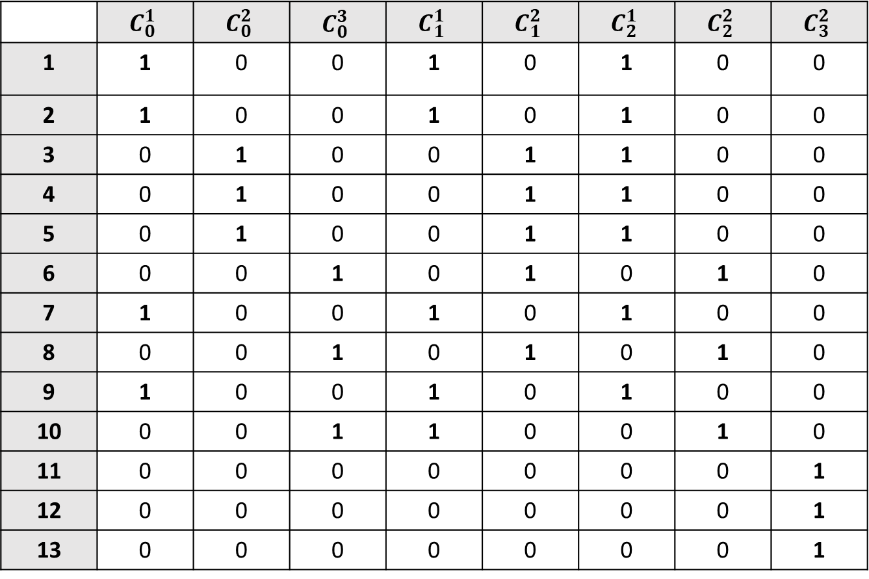
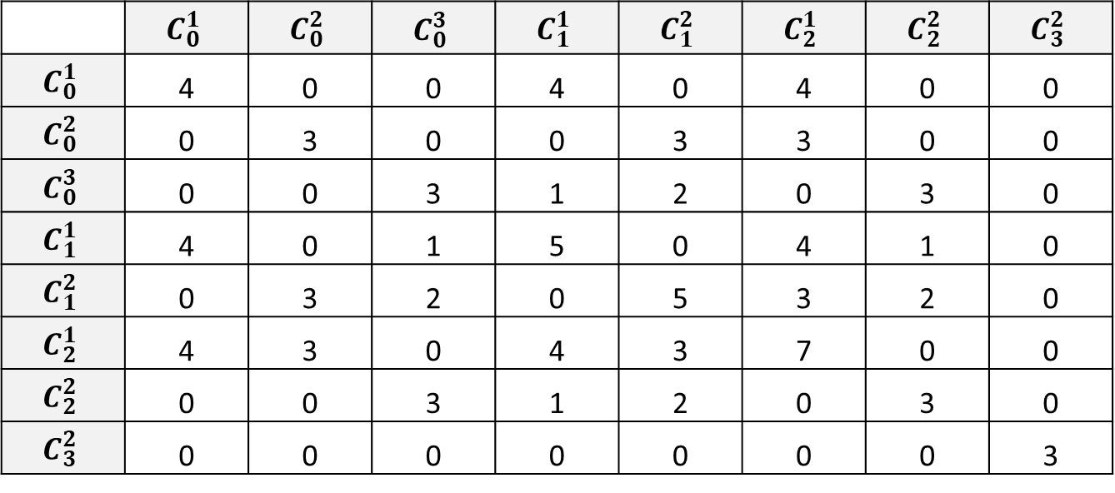
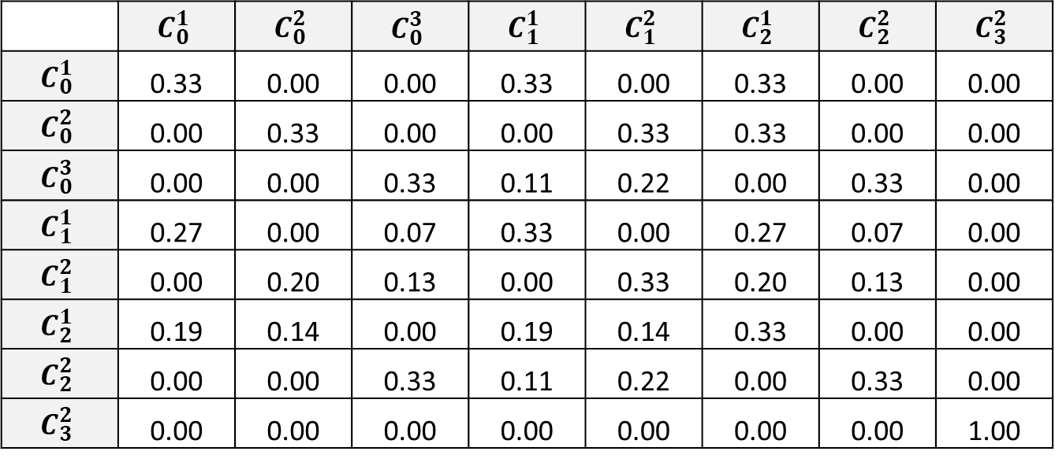
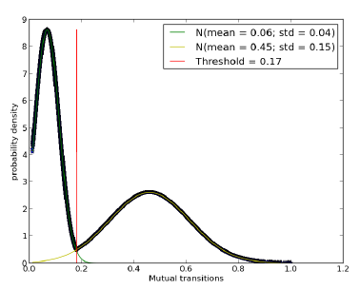








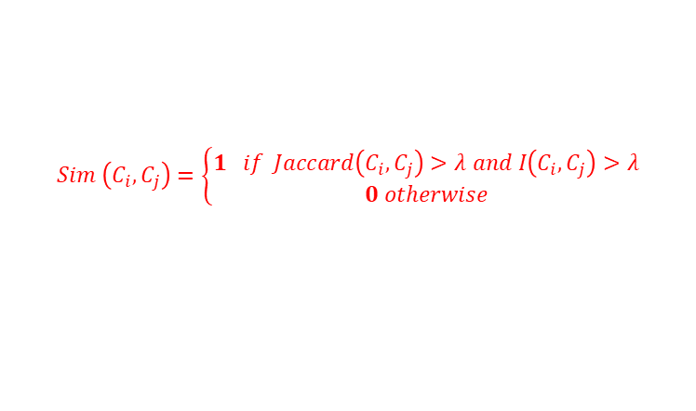














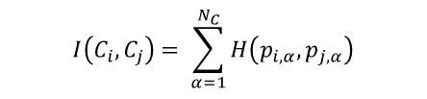
Community Matching – Mutual Transition
[Tajeuna et al.]
Similarity Measure : Mutual Transition $→ Jaccard\left(C_{i},C_{j}\right)>λ and I\left(C_{i},C_{j}\right)$ $>λ$
Similarity Threshold : Defined Automatically $→ λ$
$$t=0$$
$$t=1$$
$$t=2$$
$$10$$
$$3$$
$$4$$
$$1$$
$$2$$
$$1$$
$$2$$
$$1$$
$$5$$
$$2$$
$$9$$
$$7$$
$$C_{0}^{1}$$
$$9$$
$$7$$
$$9$$
$$7$$
$$C_{1}^{1}$$
$$C_{2}^{1}$$
$$3$$
$$4$$
$$3$$
$$4$$
$$8$$
$$10$$
$$5$$
$$8$$
$$5$$
$$6$$
$$6$$
$$Membership Matrix (A)$$
$$Burt Matrix (B= A^{T}×A)$$
$$Probability Matrix (Burt Normalized)$$
$$C_{0}^{2}$$
$$C_{1}^{2}$$
$$C_{2}^{2}$$
$$10$$
$$11$$
$$12$$
$$H\left(p_{i,α},p_{j,α}\right)=2\frac{p_{i,α}×p_{j,α}}{p_{i,α}+p_{j,α}}$$
$$8$$
$$6$$
$$C_{0}^{3}$$
$$13$$
$$C_{3}^{2}$$
$\text{Jaccard} \left(C_{i},C_{j}\right)=\frac{B_{i,j}}{B_{i,i}+B_{j,j}−B_{i,j}}$
$$I\left(C_{i},C_{j}\right)= \sum_{α=1}^{N_{C}}{H\left(p_{i,α},p_{j,α}\right)}$$
$$Sim \left(C_{i},C_{j}\right)=\left\{\begin{aligned}1 if Jaccard\left(C_{i},C_{j}\right)>λ and I\left(C_{i},C_{j}\right)>λ \\ 0 otherwise\end{aligned}\right.$$
Calculate Mutual Transition between all clusters
$$τ=\{I_{1},I_{2},…,I_{n}\}$$
$${gr}_{1}and {gr}_{2}$$
$$λ$$
Apply K-Means (K=2) on the Mutual Transition values
$$Mixture of two gaussians$$
$$f_{1}\left(λ\right)=f_{2}\left(λ\right)$$
Notes:
Looks at the entire life cycle of the graph
Automatically define the similarity threshold
It only uses one of both indices (if it ends up using the Jaccard index only it gives the same results as Green et al.)
2 evaluation metrics: Pearson correlation and Average proportion of nodes persisting

Slide 23
TRACKGAE Tracking Community Evolution With Graph Autoencoders
IV

Slide 24

















TrackGAE – Motivation
Timestep 1
Timestep 2
$$v_{6}$$
$$v_{6}$$
$$v_{4}$$
$$v_{5}$$
?
$$v_{4}$$
$$v_{5}$$
The majority of the current models only evaluate node membership when matching clusters
$$v_{4}$$
$$v_{1}$$
$$C_{1}=C_{2}$$
$$v_{4}$$
$$v_{1}$$
$$v_{7}$$
Same structure
Same attributes
Different node membership
$$v_{2}$$
$$v_{3}$$
$$v_{2}$$
$$v_{3}$$
$$v_{6}$$
$$v_{6}$$
$$v_{4}$$
$$v_{5}$$
$$v_{4}$$
$$v_{5}$$
?
$$v_{4}$$
$$v_{1}$$
$$C_{1}=C_{2}$$
$$v_{4}$$
$$v_{1}$$
It is better to evaluate all 3 metrics:
Node membership
Cluster structure
Cluster attributes
Same attributes
Same node membership
Different structure
$$v_{2}$$
$$v_{3}$$
$$v_{2}$$
$$v_{3}$$
$$v_{6}$$
$$v_{6}$$
$$v_{4}$$
$$v_{5}$$
$$v_{4}$$
$$v_{5}$$
?
$$v_{4}$$
$$v_{1}$$
$$C_{1}=C_{2}$$
$$v_{4}$$
$$v_{1}$$
Same structure
Same node membership
Different attributes
$$v_{2}$$
$$v_{3}$$
$$v_{2}$$
$$v_{3}$$

Slide 25












































TrackGAE – Method
Generating Sequences = Clustering on the Supergraph
$$t=0$$
$$t=1$$
$$t=2$$
$$3$$
$$4$$
$$4$$
$$5$$
$$1$$
$$2$$
$$1$$
$$10$$
$$2$$
$$1$$
$$S_{1}$$
$$C_{2}^{1}$$
$$7$$
$$5$$
$$2$$
$$4$$
$$C_{0}^{1}$$
$$4$$
$$C_{1}^{1}$$
$$4$$
$$9$$
$$7$$
$$C_{0}^{1}$$
$$9$$
$$7$$
$$9$$
$$7$$
$$1$$
$$C_{1}^{1}$$
$$C_{2}^{1}$$
$$3$$
$$4$$
$$3$$
$$4$$
$$8$$
$$10$$
$$3$$
$$3$$
$$C_{1}^{2}$$
$$3$$
$$3$$
$$5$$
$$8$$
$$6$$
$$6$$
$$S_{2}$$
$$C_{0}^{2}$$
$$C_{2}^{2}$$
$$C_{0}^{2}$$
$$5$$
$$C_{1}^{2}$$
$$C_{2}^{2}$$
$$3$$
$$2$$
$$Burt Matrix (B= A^{T}×A)$$
$$1$$
$$10$$
$$11$$
$$12$$
$$3$$
$$5$$
$$3$$
$$8$$
$$6$$
$$C_{0}^{3}$$
$$13$$
$$C_{3}^{2}$$
Equivalent to an adjacency matrix of a weighted graph with self-loops
$$C_{0}^{3}$$
$$2$$
$$C_{2}^{3}$$
$$S_{3}$$
$$3$$
$$G_{0}$$
$$G_{1}$$
$$G_{2}$$
$$S_{4}$$
$$Supergraph$$
Temporal GAE
(Pretrain)
Generate temporal representations of the clusters that capture the:
node membership / attributes / structure
Of the clusters
1
Clusters representations
Supergraph structure and weights
Clustering GAE
(Tracking)
Cluster the clusters in the Supergraph into sequences
2

Slide 26








































TrackGAE – Pretrain
Timestep 0
Timestep 1
…
Timestep n
$${GAE}_{0}_SUM(G_{0})$$
$${GAE}_{1}_SUM(G_{1})$$
$${GAE}_{n}_SUM(G_{n})$$
$$l_{1}$$
$$l_{2}$$
$$l_{1}$$
$$l_{2}$$
$$l_{1}$$
$$l_{2}$$
$$A_{0}$$
$$A_{1}$$
$$A_{n}$$
Encoder
$$X_{0}$$
$$X_{1}$$
$$X_{n}$$
$$encoding$$
$$encoding$$
$$encoding$$
$$h_{1}∥h_{2}$$
$$H_{0}$$
$$h_{1}∥h_{2}$$
$$H_{1}$$
$$h_{1}∥h_{2}$$
$$H_{n}$$
$$Z_{0}$$
$$GRU(Z_{0},H_{1)}$$
$$Z_{1}$$
$$Z_{n−1}$$
$$GRU(Z_{n−1},H_{n)}$$
Embedding
$$Z_{0}$$
Embedding
$$Z_{1}$$
$$Z_{n−1}$$
Embedding
$$Z_{n}$$
$$sigmoid(Z_{0}Z_{0}^{T})$$
$$sigmoid(Z_{1}Z_{1}^{T})$$
$$sigmoid(Z_{n}Z_{n}^{T})$$
Reconstruct Adjacency
$${\overline{A}}_{0}$$
Reconstruct Adjacency
$${\overline{A}}_{1}$$
Reconstruct Adjacency
$${\overline{A}}_{n}$$
Decoder
$$sigmoid(Z_{0}W)$$
$$sigmoid(Z_{1}W)$$
$$sigmoid(Z_{n}W)$$
Reconstruct Attributes
$${\overline{X}}_{0}$$
Reconstruct Attributes
$${\overline{X}}_{1}$$
Reconstruct Attributes
$${\overline{X}}_{n}$$
$$softmax(Z_{0}W)$$
$$softmax(Z_{1}W)$$
$$softmax(Z_{n}W)$$
Classify nodes to $G_{0}$ Clusters
$${\overline{C}}_{0}$$
Classify nodes to $G_{1}$ Clusters
$${\overline{C}}_{1}$$
Classify nodes to $Z_{2}$ Clusters
$${\overline{C}}_{n}$$
$$X_{C_{0}}$$
$$X_{C_{0}^{i}}=Mean(z_{v}|v∈C_{0}^{i})$$
$$X_{C_{1}}$$
$$X_{C_{1}^{i}}=Mean(z_{v}|v∈C_{1}^{i})$$
$$X_{C_{n}}$$
$$X_{C_{n}^{i}}=Mean(z_{v}|v∈C_{n}^{i})$$
${ X}_{C}$ (Supergraph attributes)
Notes:
Aggregate node representations for new nodes in the next timestep

Slide 27










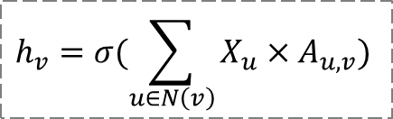







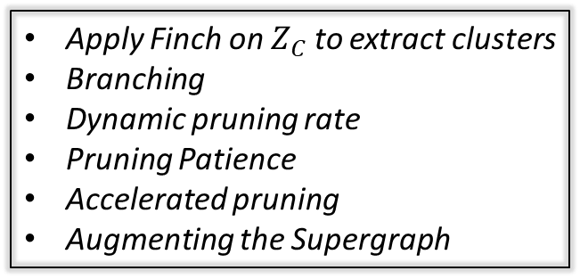









TrackGAE – Tracking
$$TrackGAE(G_{C})$$
$$Agrregation Rule$$
$$5$$
$$h_{v}=σ(\sum_{u∈N\left(v\right)}{X_{u}×A_{u,v}})$$
$$S_{1}$$
$$4$$
$$C_{2}^{1}$$
$$7$$
$$l_{1}$$
$$l_{2}$$
$$4$$
$$C_{0}^{1}$$
$$4$$
$$C_{1}^{1}$$
$$4$$
$$1$$
$$A_{C}$$
$$X_{C}$$
Encoder
$$3$$
$$3$$
$$C_{1}^{2}$$
$$3$$
$$3$$
$$Pruning Rule$$
$$S_{2}$$
$$C_{0}^{2}$$
$$C_{2}^{2}$$
$$3$$
$$2$$
$$encoding$$
$$A_{u,v}=A_{u,v}−(\log_{10}(dist\left(Z_{u},Z_{v}\right))×ρ)$$
$$1$$
$$5$$
$$h_{1}∥h_{2}$$
$$3$$
$$3$$
$$A_{C}^{,}$$
$$C_{0}^{3}$$
$$2$$
$$C_{2}^{3}$$
Pruning
$$Z_{C}$$
$$S_{3}$$
$$3$$
$$S_{4}$$
Sample $k$ edges randomly
Reconstruct Adjacency
Decoder
$$Supergraph$$
$$A_{C}$$
$$sigmoid(ZZ^{T})$$
$${\overline{A}}_{C}$$
Apply Finch on $Z_{C}$ to extract clusters
Branching
Dynamic pruning rate
Pruning Patience
Accelerated pruning
Augmenting the Supergraph
Notes:
There is also branching

Slide 28



















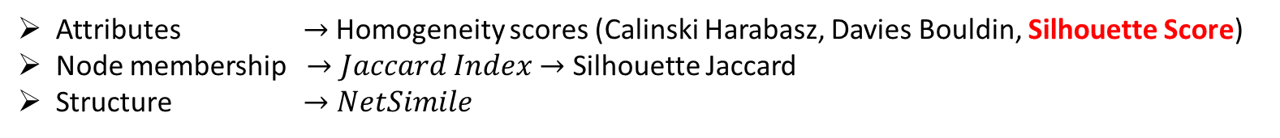

TrackGAE – Evaluation
Attributes $→$ Homogeneity scores (Calinski Harabasz, Davies Bouldin, Silhouette Score)
Node membership $→Jaccard Index$ $→$ Silhouette Jaccard
Structure $→NetSimile$
Introduced by the Mutual Transition paper:
Average Proportions of nodes persisting
Pearson Correlation on the probability vectors of the clusters
Should have the best score
Should have the worst score
Current Metrics Give this case
the best score
$$S_{1}$$
$$S_{1}$$
$$S_{1}$$
$$→$$
$$S_{2}$$
$$S_{2}$$
$$S_{3}$$
$$S_{3}$$
$$S_{4}$$
$$S_{4}$$
$$S_{5}$$
$$S_{5}$$
$$S_{6}$$
$$S_{7}$$
$$S_{8}$$
$$S_{9}$$
$$S_{10}$$
$$SH=\frac{inter−intra}{max⁡(inter,intra)}$$
$${SH}_{Jaccard}=\frac{intra−inter}{max⁡(inter,intra)}$$
$$S_{11}$$
Notes:
Silhouette : inter-intra / max(inter,intra)
Silhouette jaccard : intra-inter/ max(inter,intra)

Slide 29
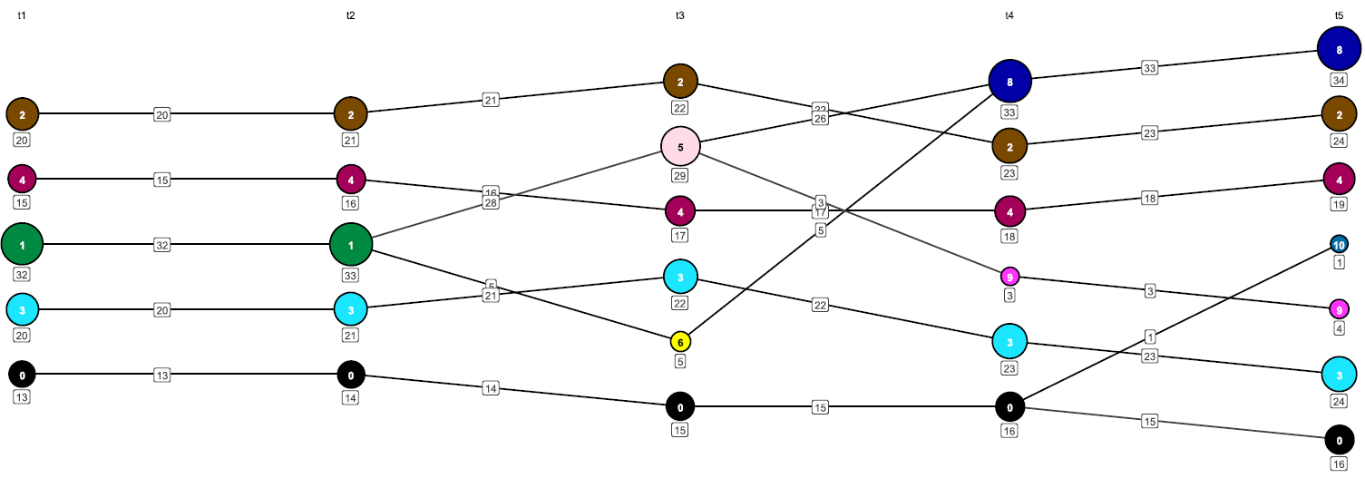
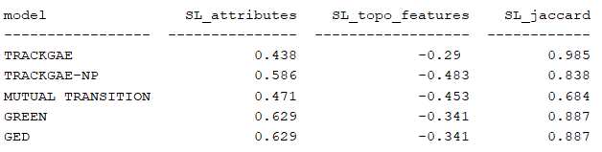
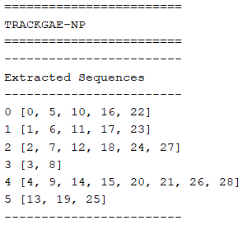
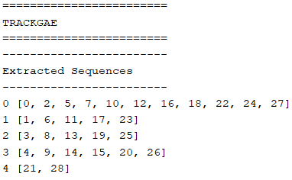
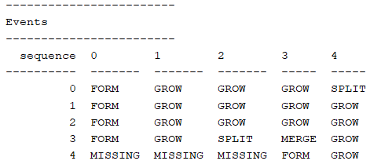
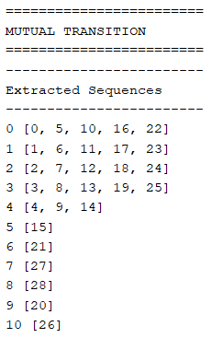
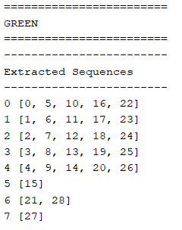
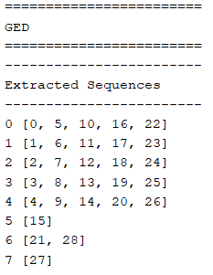
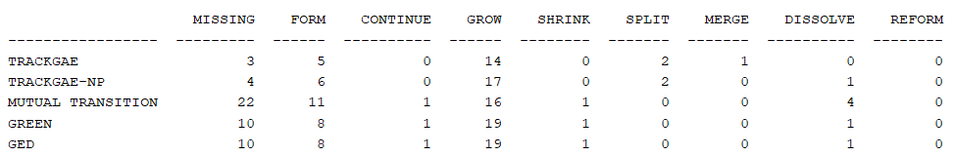
TrackGAE – Dancer Example 1
26
11
20
1
6
23
14
17
0
5
22
10
16
4
9
27
13
21
3
8
28
7
15
19
2
25
12
18
24
(TrackGAE)

Slide 30
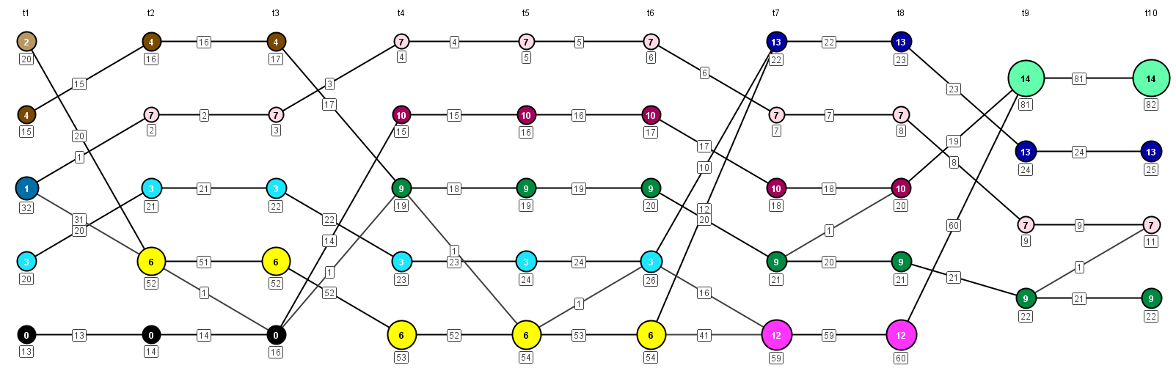
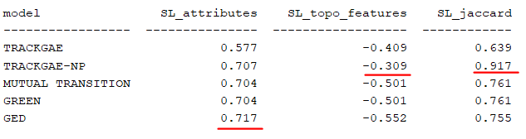
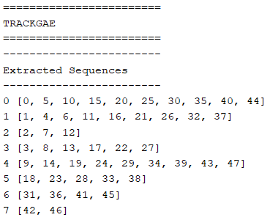
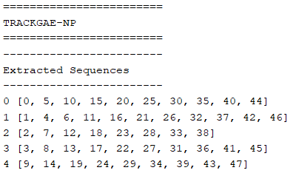
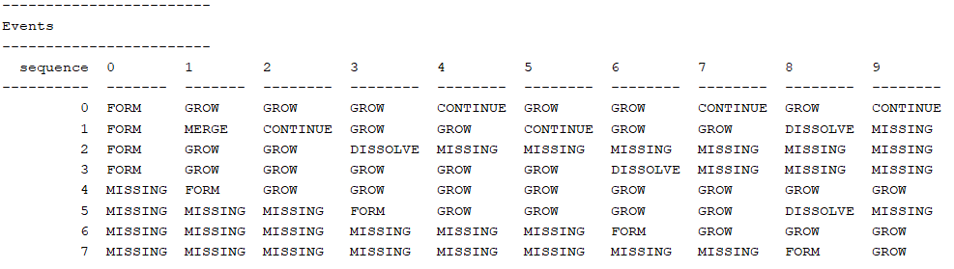
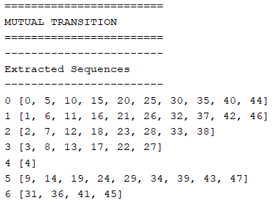
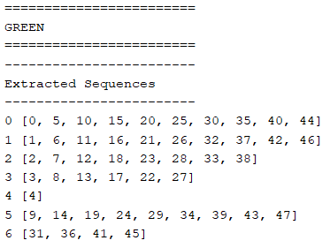
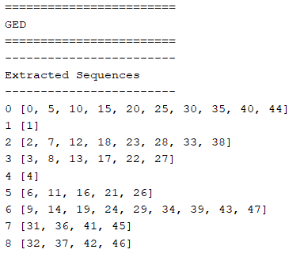
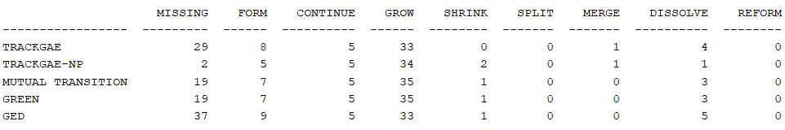
TrackGAE – Dancer Example 2
1
5
10
19
24
29
31
36
42
46
0
9
14
18
23
28
34
39
13
20
41
45
4
8
15
25
33
38
11
22
43
47
3
6
17
27
30
35
21
40
44
2
7
12
16
26
32
37
(TrackGAE)

Slide 31
Conclusion
V

Slide 32
Conclusion
Two main approaches for treating dynamic graphs : Discrete snapshots or continuous events.
Multiple approaches to tracking clusters in dynamic graphs.
Most benchmarks rely on node membership for tracking the clusters.
Main challenges for tracking clusters:
Defining the sequences that preserve the identity of the evolving archetype cluster.
Evaluating the extracted sequences.
Using deep learning for cluster tracking is still an open challenge.

Slide 33
References
[1] Brodka, P., Saganowski, S. et Kazienko, P. (2012). GED: the method for group evolution discovery in social networks. CoRR.
[2] Cazabet, R. and Rossetti, G. (2019). Challenges in community discovery on temporal networks. CoRR.
[3] Dakiche, N., Tayeb, F. B., Slimani, Y. et Benatchba, K. (2019). Tracking community evolution in social networks: A survey. Inf. Process. Manag. ,56(3), 1084–1102.
[4] Greene, D., Doyle, D. et Cunningham, P. (2010). Tracking the evolution of communities in dynamic social networks. In International Conference on Advances in Social Networks Analysis and Mining, 176–183.
[5] Rossi, E., Chamberlain, B., Frasca, F., Eynard, D., Monti, F. et Bronstein, M. M. (2020). Temporal graph networks for deep learning on dynamic graphs. CoRR.
[6] Tajeuna, E. G., Bouguessa, M. et Wang, S. (2015).Tracking the evolution of community structures in time-evolving social networks. In IEEE International Conference on Data Science and Advanced Analytics, 1–10.

